Slide 1
Former Scholler, Inc.
3320 Collins Street a.k.a. 2101 – 2109 East Westmoreland Street
Act 2 Land Recycling
Public Involvement Program
John Lydzinski, P.G.
RT Environmental Services., Inc.

Slide 2
Site History
Prior to 1930 - Residential Community
Early 1930’s - Small Soap Factory constructed on Parcels
Building expanded on several occasions up through 1940
Scholler Brothers, Inc. later renamed Scholler, Inc. operated on the property until the 1980’s
Property purchased by Arawak Holding Corporation in 1998
DGPM1, LLC purchased a portion of the property for redevelopment in 2019.

Slide 3
Site History (Continued)
Two USTs removed from open yard area on Amber Street in 1993
10,000-gallon fuel oil UST closed in 1998
Non-use Aquifer Determination approved by PADEP on May 13, 1998
Combined Remedial Investigation/Act 2 Final Report approved 2003
Final Report demonstrated attainment of Site Specific Standard for No’s. 2, 4 and 6 fuel oil constituents in soil & groundwater

Slide 4
Site History (Continued)
Prohibits groundwater use and restricts development to non-residential
Additional site characterization information obtained in 2018
Fifteen soil borings indicated two areas in former warehouse impacted with chlorinated solvents and/or benzo(a)pyrene
Four shallow and three deep groundwater wells installed in 2018
Groundwater sampling completed in January & February 2020

Slide 5
Remediation & Groundwater Monitoring
Two small affected soil areas (low level PCE, TCE & Benzo(a) pyrene) will be remediated (excavated) during building demolition
Approximately 4-feet of soil will be removed from Area 1 and 2-feet from Area 2
Excavated material will be disposed at PADEP permitted facility
Groundwater will continue to be monitored for TCE concentrations which are currently below Non-Use Aquifer limits (50 mg/L) in well 19D

Slide 6
Land Use Modification
Through the submittal of an Act 2 Final Report, DGPM1, LLC will request a change in land use from non-residential to residential development
Groundwater use will continue to be restricted
An Environmental Covenant restricting groundwater use will be submitted to the PADEP and attached to the current deed.

Slide 7
RE-DEVELOPMENT AREA
Portion of the property to undergo redevelopment is located at 2101 – 09 E. Westmoreland Street
Lot to be redeveloped consists of 17,085 ft²
Building 1 is an existing 4-story structure which will be renovated with 11 apartment units
Building 2, currently occupied by brick warehouse to be razed, will consist of 4-story new construction (48 apartment units)
Both buildings will front on Amber Street while Building 2 will also maintain frontage on E Westmoreland Street

Slide 8
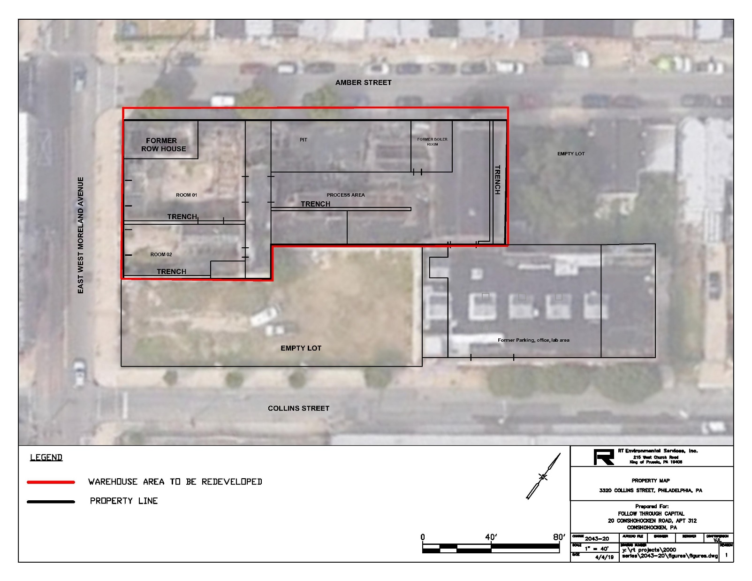
Property Map

Slide 9
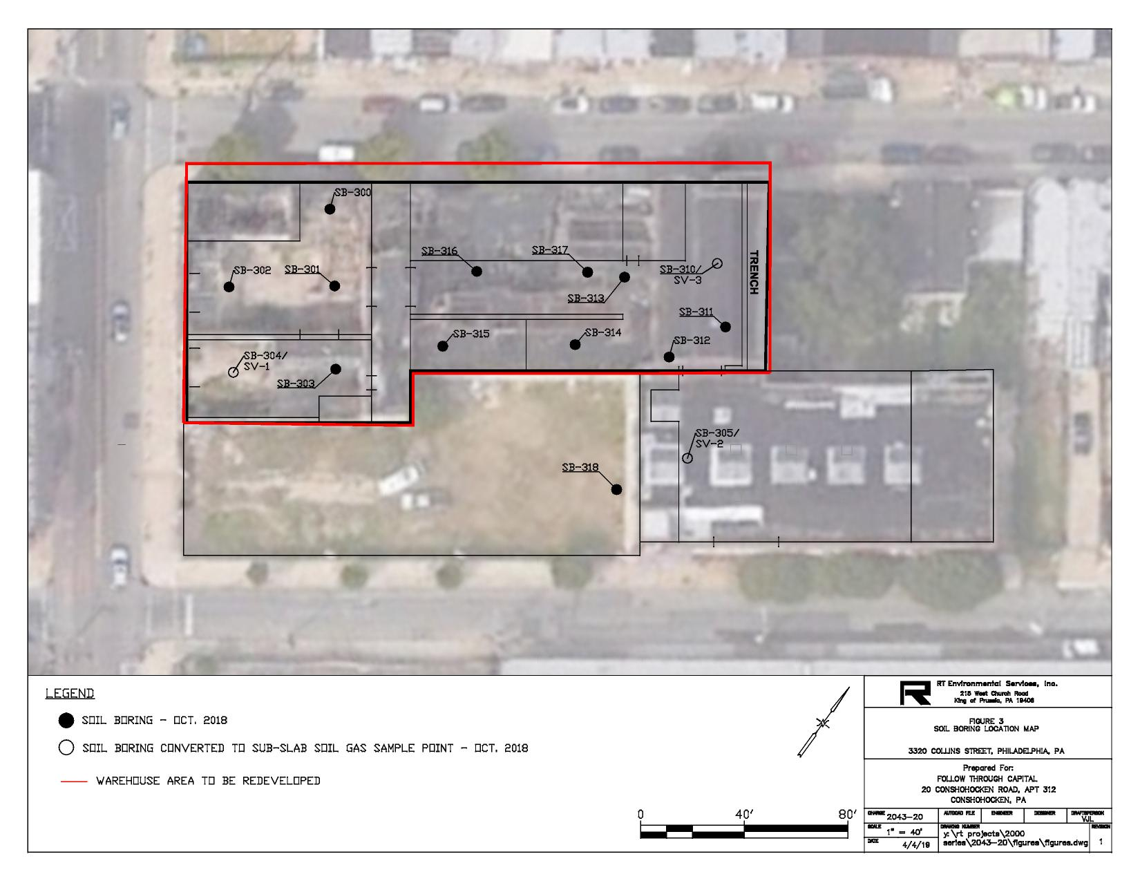
Soil Boring Location Map

Slide 10
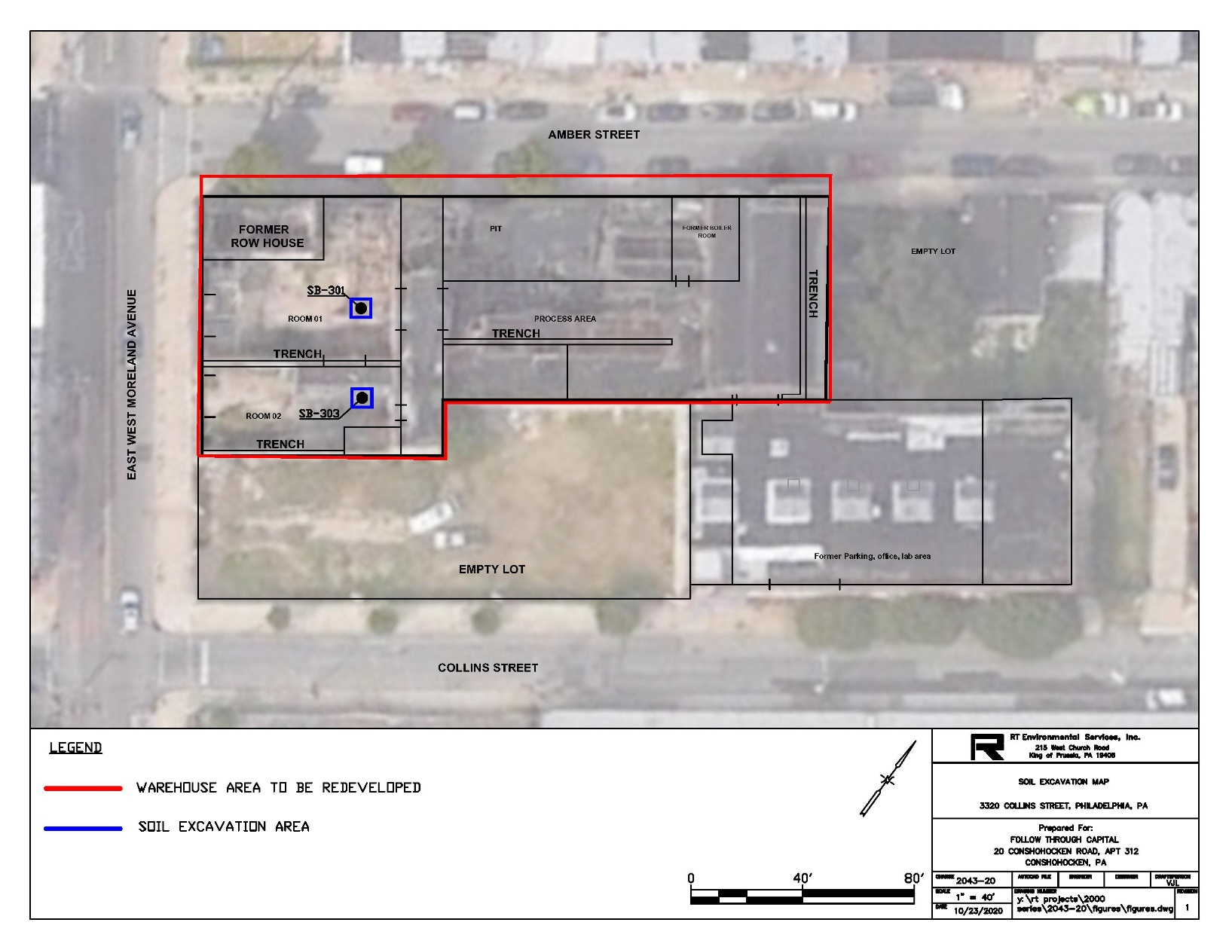
Area Excavation Map

Slide 11
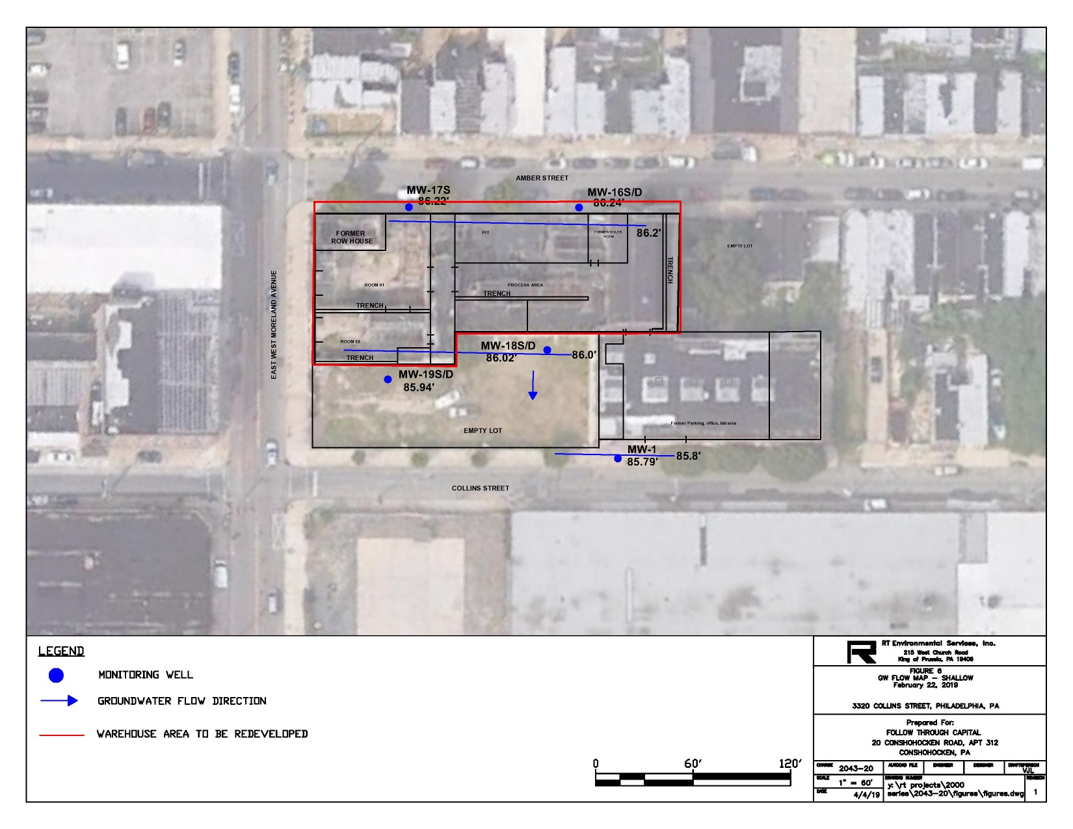
Groundwater Flow - Shallow

Slide 12
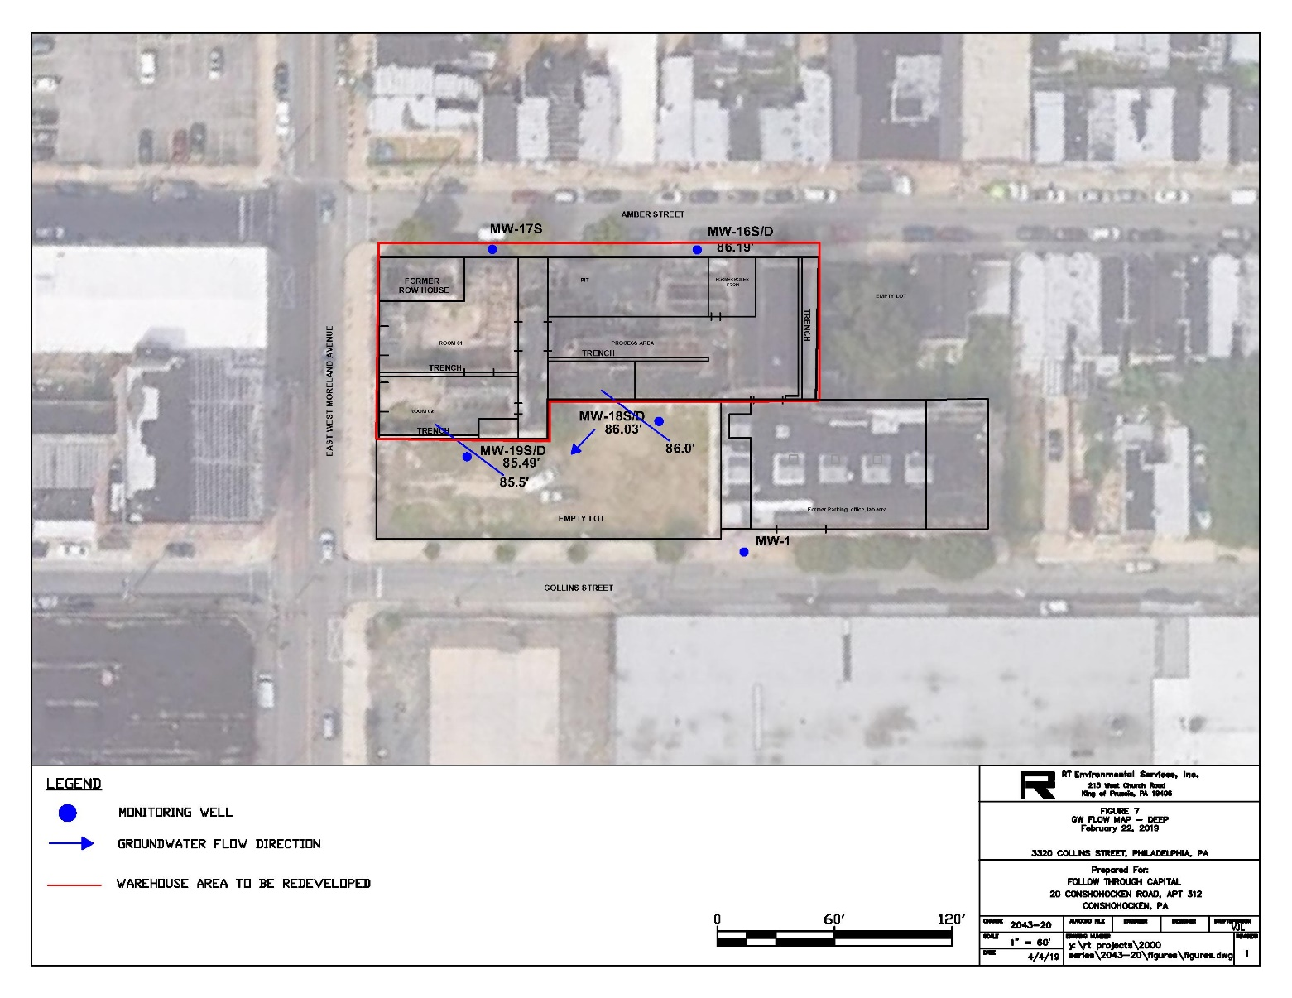
Groundwater Flow - Deep

Slide 13
Proposed Redevelopment Site Plan

Slide 14
Remedial Approach
Pathway Elimination via Soil Excavation
  Confirmed that all pathways are incomplete or residual contaminants pose negligible risk
    Soil (site impact areas are excavated and vapor barrier installed in new construction)
    Groundwater (no users or access to groundwater)
    Submittal of Act 2 Final Report (Statewide Health –soil)
    Vapor Intrusion (post construction vapor testing)
  Environmental Covenant
    Continue restriction of groundwater use

Slide 15
Public Involvement Program
Information/Comments
Remedial Investigation Report and Site Development Plan available for Review at the following link: www.rtenv.com under Resources
Any comments can be submitted to:
      RT Environmental Services, Inc.
      215 West Church Road
      King of Prussia, PA 19406
      Attention: John Lydzinski
      Email: jlydzinski@rtenv.com
Comments Due by November 18, 2020

Slide 16
Virtual Public Meeting
A Zoom Meeting will be held at 5:00 PM on Wednesday November 18th
Join the meeting at the following address: https://us04web.zoom.us/j/76145732763?pwd=aCtCOXp5Y1ZHK0NCY3BLeG5RYjRxdz09
Meeting ID: 761 4573 2763

